Slide 1
Calorie Tracker - Iteration 3
CS673 Team3 Presentation
Instructor : Professor Yuting Zhang

Slide 2
Team Members Role
Corydon Wood [ Configuration Leader ]
Aditya Prakash [ Design and Implementation Leader ]
Zuowen Tang [ Security / QA Leader ]
Alekhya Koppineni [ Requirement Leader ]
Umamaheswar Edara [ Team Leader ]

Slide 3
Individual Contribution of Team Members
Corydon Wood - Configuration Leader
Responsible for managing project configurations, version control system, development & deployment processes.
Designed base styling & templates, food journal, food database frontend & APIs.
Ensured smooth integration of software components and handled environment setups.
Handling Docker and AWS deployments.
Aditya Prakash - Design and Implementation Leader
Led the design and implementation phase of the project.
Collaborated with the team to create an intuitive user interface.
Implemented key functionalities and ensured adherence to design specifications.
Zuowen Tang - Security / QA Leader
Conducted thorough security assessments and implemented necessary security measures.
Performed and documented rigorous testing to identify and fix bugs, ensuring a stable application.
Coordinated, rescheduled, and documented meetings.
Implemented frontend, database, and key functions of social media, as well as user authentication.
Alekhya Koppineni - Requirement Leader
Played a crucial role in gathering and documenting project requirements.
Ensured that the implemented system satisfies requirements and performs impact analysis for any changes or enhancements.
Managed changes to the requirements throughout the project lifecycle.
Ensured that the final product met the specified functional and non-functional requirements.
Umamaheswar Edara - Team Leader
Oversaw the overall project management and coordination.
Facilitated effective communication and collaboration within the team.
Monitored progress, managed timelines, and ensured project milestones were met.
Contributed on Front end, google authentication, django admin, and some parts of user Authentication.
Apart From their roles contributions, All team members had contributed to the Code Base and worked hard to achieve this.

Slide 4
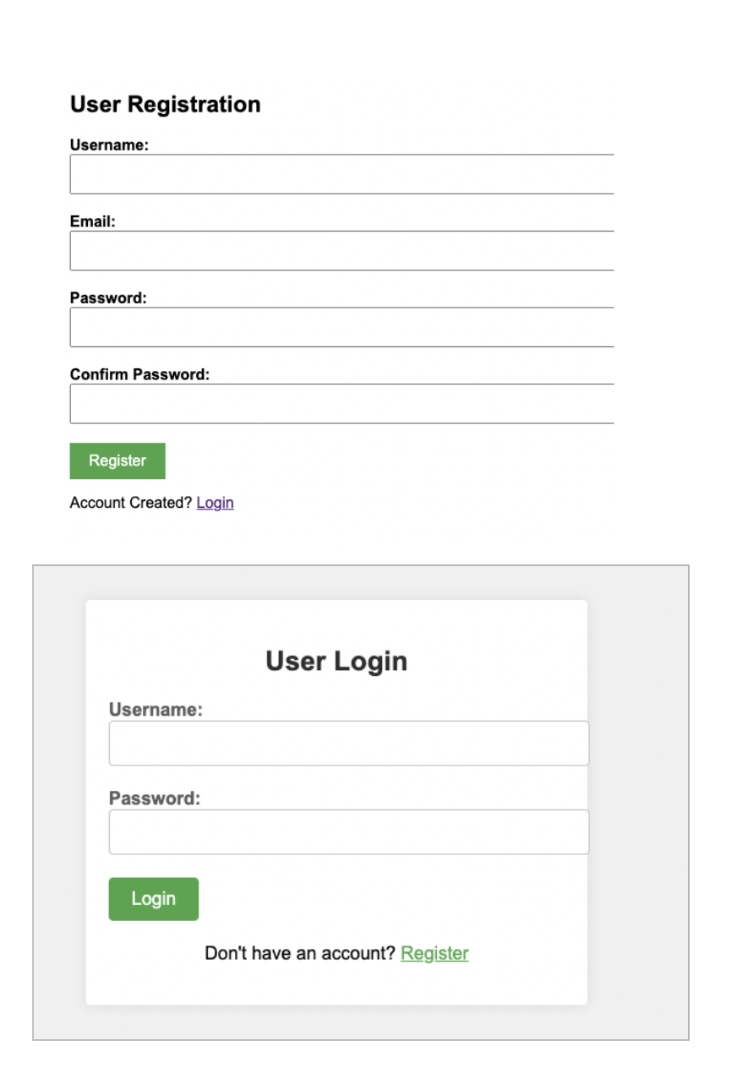
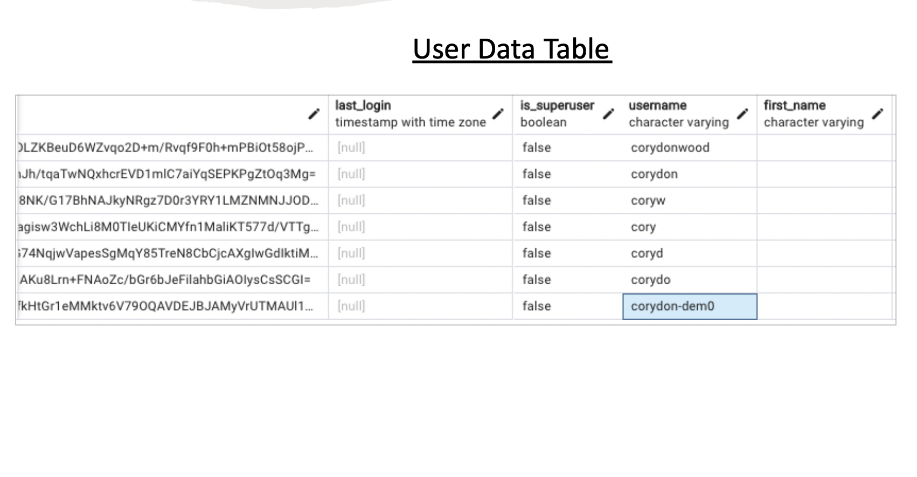
Iteration1
Front End and Back End Progress
Login and Registration Functionality
Setting Up DB and Application Architecture
Food Journal Functionality

Slide 5
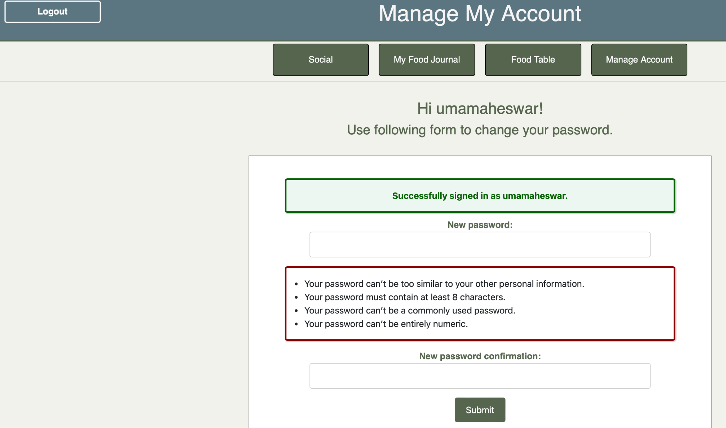
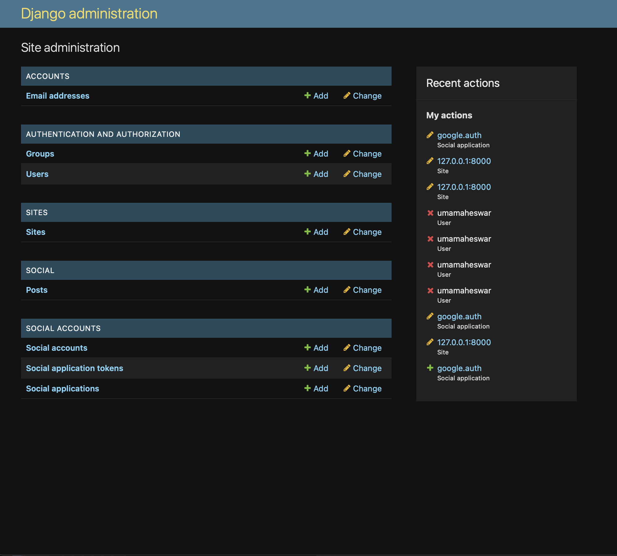
Front End and Back End Progress
Iteration2
Progress
Gmail Conformation for Login Functionality
Profile Password Reset Functionality
Food History View Functionality
Calorie Counting Functionality
Django Admin Functionality
Google Login Functionality
Updating Github Pages
Password Reset Functionality
Visualization Functionality

Slide 6
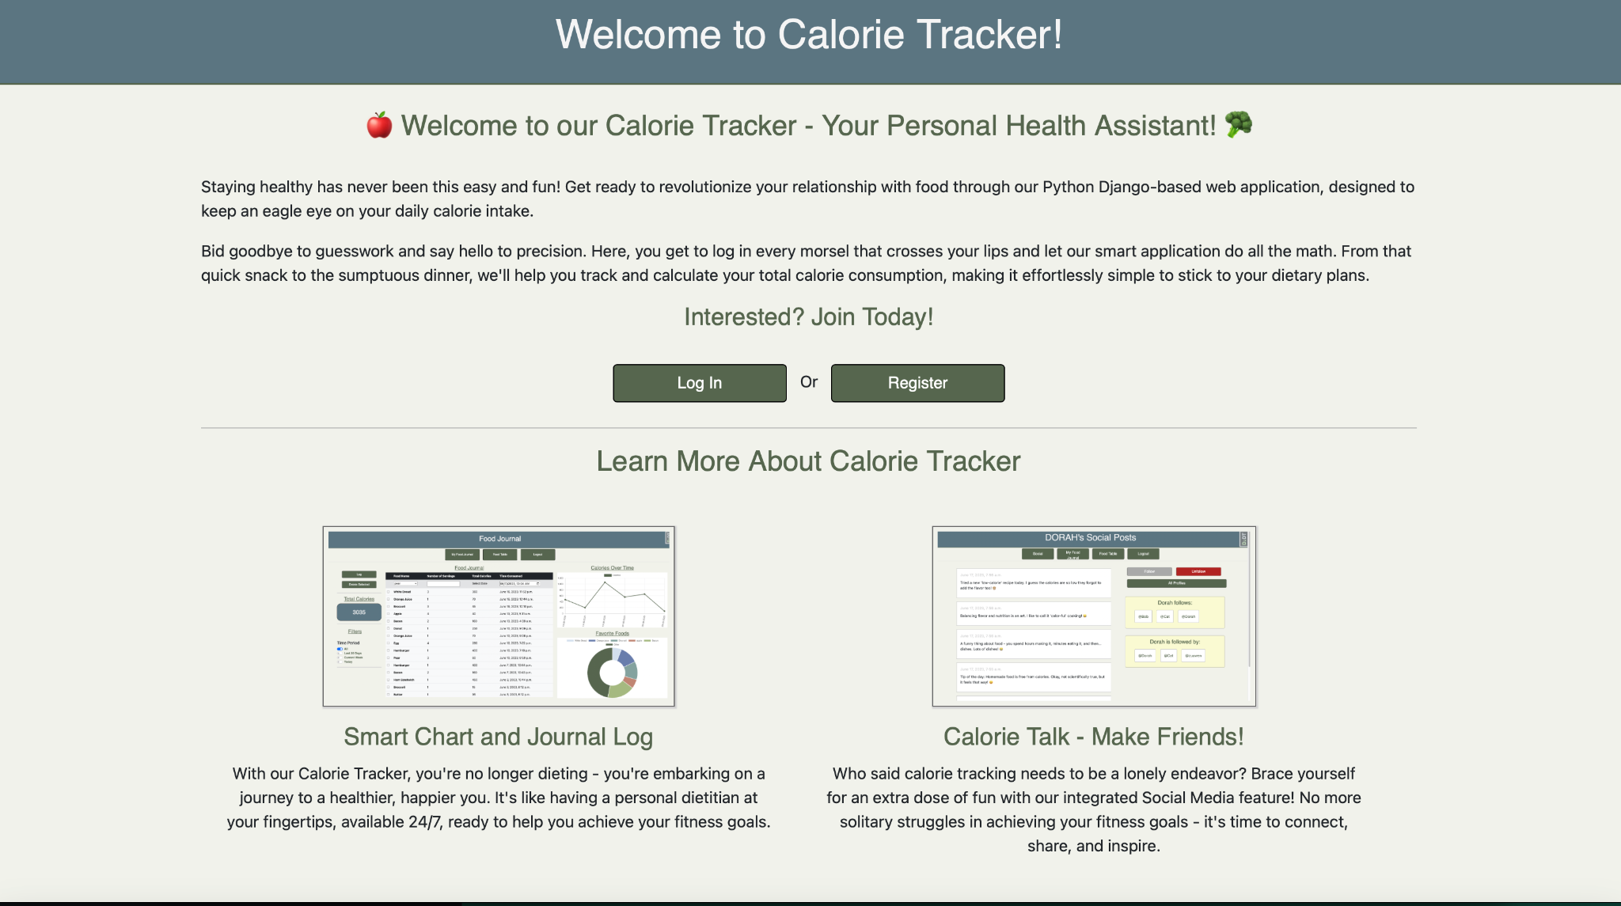
Iteration3
Fully Functional Django Web Application
Dockerizing Django Web Application
Deploying with AWS EC2
Social Sharing Functionality

Slide 7
Risk Management
Identification of Risks
Conducted a comprehensive risk assessment to identify potential risks and uncertainties during every Iteration.
Identified risks related to duplicate work, worked on wrong components, Technology Miscommunication, Not familiar with the framework used, etc.
Risk Analysis
Evaluated the impact and likelihood of each identified risk.
Prioritized risks based on their potential severity and probability of occurrence.
Categorized risks based on Priority (lowest number has high priority)to focus mitigation efforts effectively.
Link : https://docs.google.com/spreadsheets/d/1F7NgvEv7hx3lGqsx5UF1zMXdne4xvG91uIpnvxyj8Pw/edit#gid=0
Risk Mitigation Strategies
Developed proactive strategies to mitigate identified risks.
Implemented preventive measures to reduce the likelihood of risks occurring.
Monitoring and Control
Established a monitoring mechanism (Google Sheet) to track the status of identified risks.
Regularly reviewed and updated the risk register to reflect any changes.
Implemented risk control measures(Communication with Team Members) to minimize the impact of identified risks.
Communication and Reporting
Maintained open communication channels to report and discuss risks.Team Members Communicated through one on one and in Group calls .
Lessons Learned
Captured lessons learned from managing risks throughout the project.
Identified areas for improvement in risk identification, analysis, and mitigation.
Documented best practices to be applied in future projects to enhance risk management.

Slide 8
Learnings
Team Members can help others with assigned user stories and share required Learning/Work resources to everyone.
We learned the importance of clear and consistent communication among team members, stakeholders, and clients. Regular status updates, meetings, and documentation helped to avoid misunderstandings and keep everyone aligned. We used various tools to track progress and assign user stories
Adopting an agile project management approach allowed us to be more flexible and responsive to changing requirements and Time Constraints. We learned the value of iterative development, frequent feedback loops, and prioritizing deliverables based on customer needs.
We realized the significance of proactive risk management. Identifying potential risks early on, analyzing their impact, and implementing mitigation strategies helped us to minimize the impact of unforeseen events and maintain project progress.
We realized the significance of maintaining comprehensive documentation and organized knowledge repositories. Clear and up-to-date documentation facilitated smooth handovers, knowledge sharing, and future project maintenance.

Slide 9
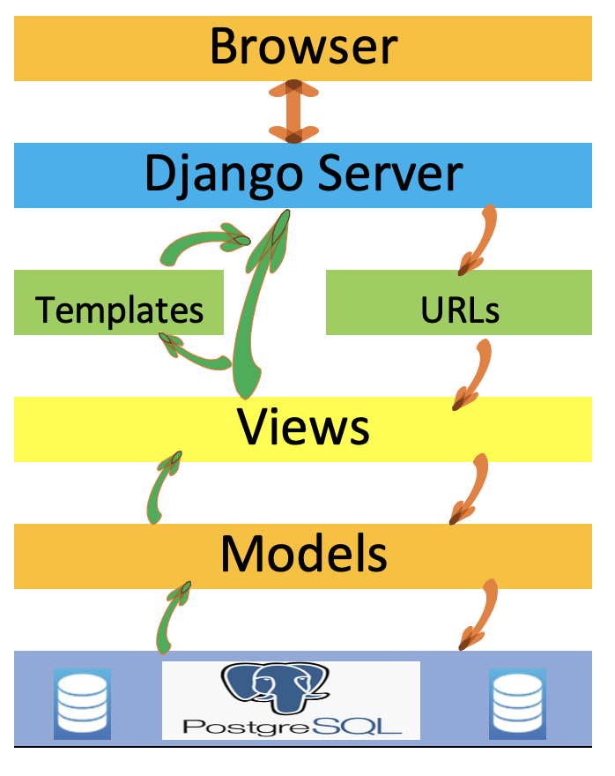
Software Architecture -Adithya
The Calorie Tracker app follows a client-server architecture, with the client being a web application built using ReactJS and the server utilizing Django framework for the backend.
The Foods app, responsible for managing food items, follows the Model-View-Template (MVT) pattern, where models define the food item attributes, views handle the business logic, and templates render the user interface.
The Login and Social apps, which handle user authentication and social interactions, also adhere to the MVT pattern, ensuring separation of concerns and allowing for efficient tracking of user calorie consumption.

Slide 10
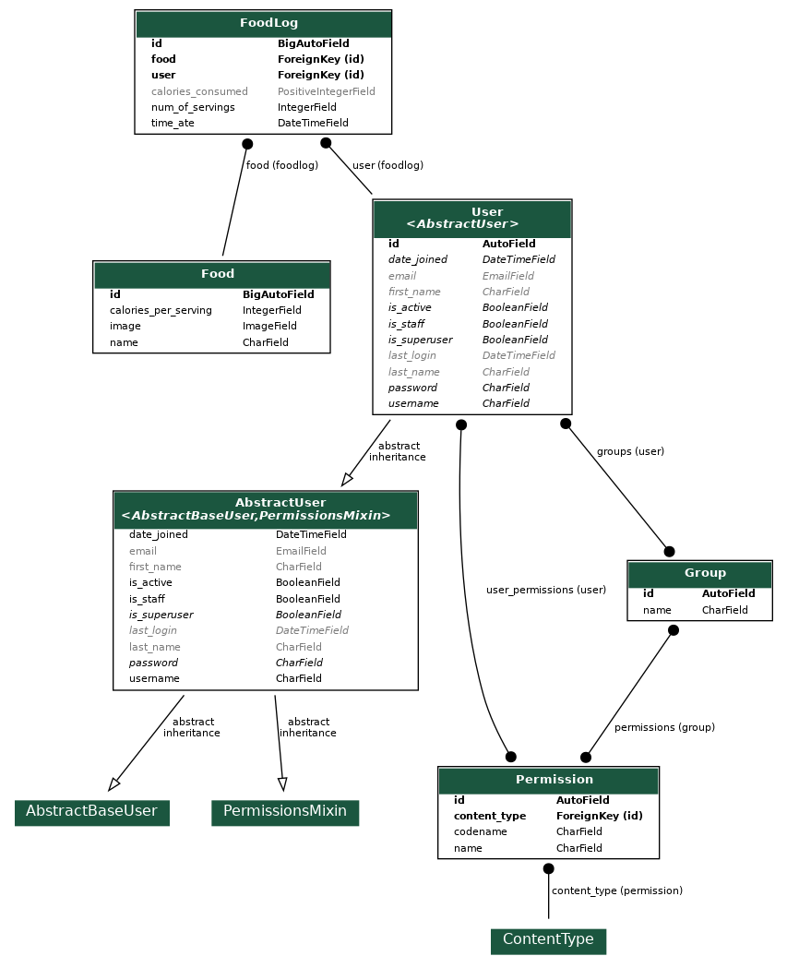
DB Design (Food & User relation) - Adithya
The database design between the django auth user and the Foods app can be established through a foreign key relationship. Each Food entry can have a foreign key reference to the User table, allowing the system to associate a specific user with their food records.
By utilizing the Django authentication system, user authentication and authorization can be seamlessly integrated with the Foods app database design. This ensures that only authenticated users can interact with the Food entries and perform relevant actions, such as adding, modifying, or deleting food records.
The database design can also include additional fields in the Foods app table to capture relevant information specific to each food entry, such as the name, calories per serving, and an optional image. These fields can provide necessary data for tracking and managing food items within the app while maintaining a consistent user experience.

Slide 11
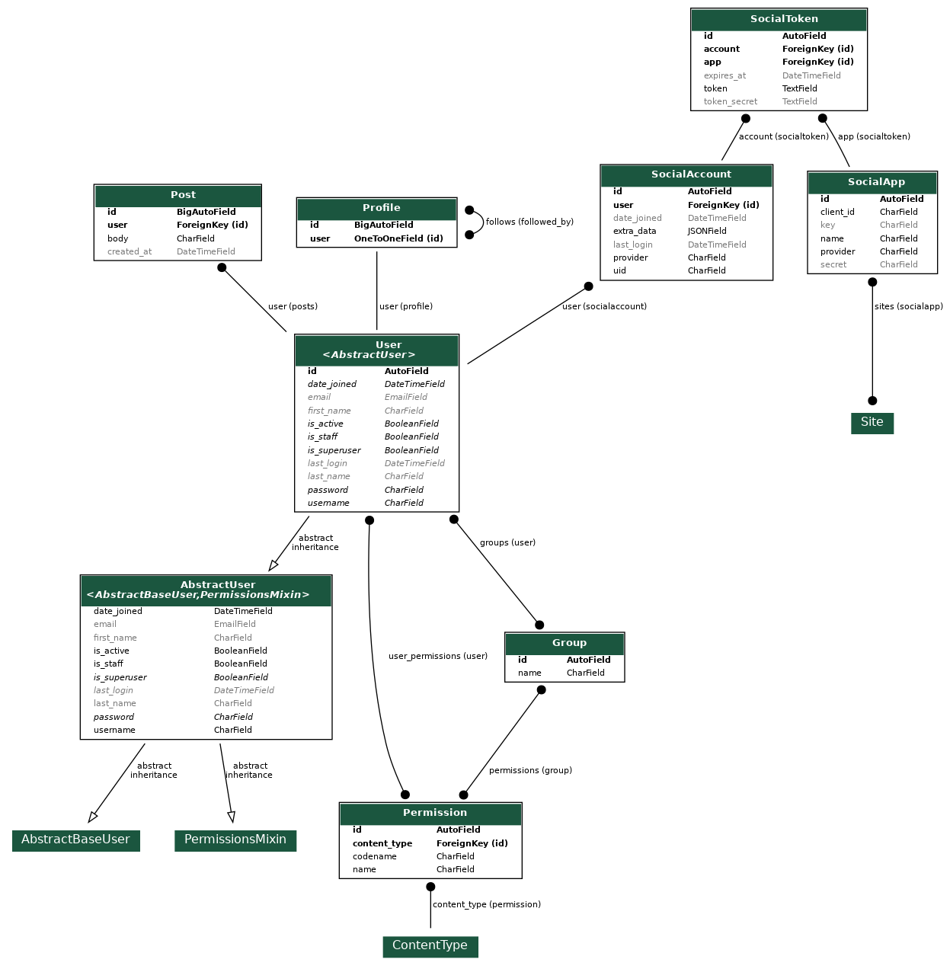
DB Design (Social & User relation) - Adithya
The Django auth user model provides user authentication and authorization functionality in the Calorie app.
The social app extends the Django auth user model by introducing the Profile model, which associates a user with their social profile and enables additional social features such as followers/following functionality. This allows users to connect and interact with each other within the app.
The relationship between the auth user model and social app is one-to-one, connecting user authentication with social functionality.

Slide 12
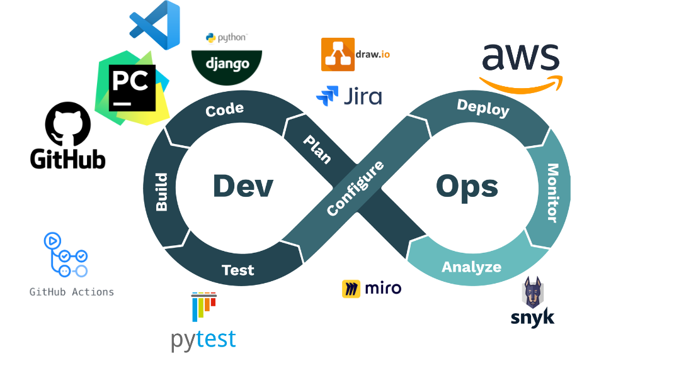
DevOps Toolkit
Base Image Source: https://news.aliasrobotics.com/content/images/2020/03/DevOps.png

Slide 13
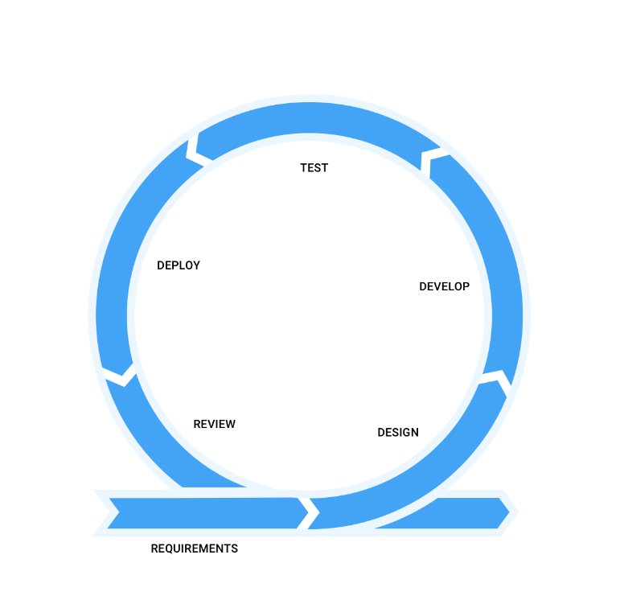
Agile Workflow
Test
Run automated PyTests as well as manual functional testing.
Develop
Develop new features on feature branches. Based on assigned tasks.
Create pull requests to integrate code into development branch.
Deploy
Merge tested code
Deployed Locally or to AWS in last iteration.
Review
Reflect as a team what was deployed how, and what the next features should be.
1-2 Week Sprint
Design
Discuss high level design, and generate Class, architecture, & other diagrams as needed.
Identify tasks and assignments
Requirements
Gather requirements, features as user stories in Jira.

Slide 14
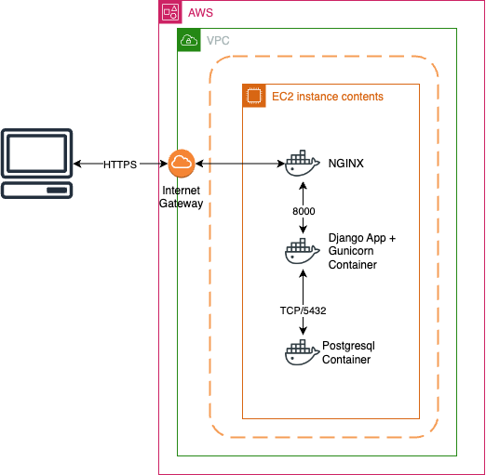
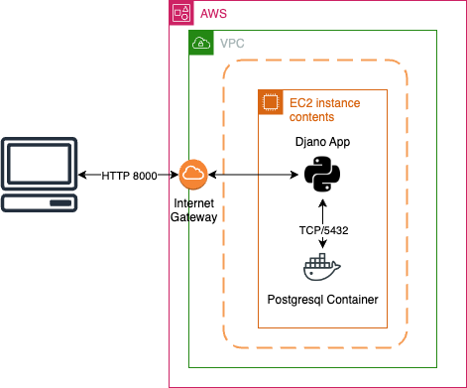

Application Deployment
Possible Future State
AWS (EC2)
Scalable web server
All services running as containers
Current
AWS (EC2)
Basic web server
Postgresql running as a container
Initial
Locally Hosted

Slide 15
Security Requirements - Zuowen
User Authentication
User authentication verifies the identity of a user by validating their credentials.
In our application, sessions are managed with a session ID, which is stored in a secure, encrypted cookie.
Password Strength
In our application, users are required to use a strong password: a combination of letters, numbers, and special characters. It should ideally be at least 8 characters long
Security storage for users’ credentials
Passwords are not stored in plaintext. Instead, we use a process called hashing to convert the password into a fixed-length sequence of characters.
We also use "salting" – adding random data to the password before hashing it – to protect against certain types of attacks.
Date Encryption

Slide 16
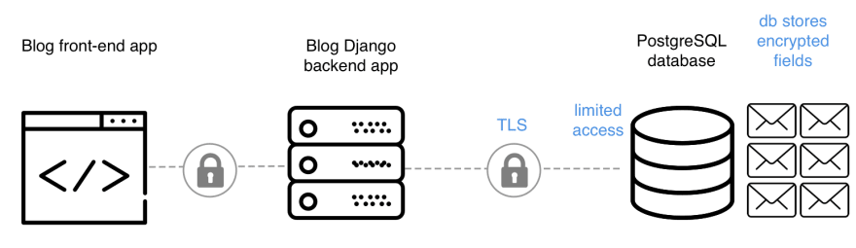
Django Data Encryption Process

Slide 17
Security Design - Zuowen
Design including user authentication, data encryption, secure session management, and secure storage of user credentials.
A role-based access control system to ensure users can only access the data and features relevant to their role.
Only email-activated users can visit the contents of website, reducing fake accounts.
We are constantly testing and updating patches to ensure the experience of the users.

Slide 18
Security Implementation and Tools - Zuowen
Cross site request forgery (CSRF) protection
Django has built-in protection against most types of CSRF attacks, providing you have enabled and used it where appropriate.
SQL injection protection
Django’s querysets are protected from SQL injection since their queries are constructed using query parameterization.
Clickjacking protection
Django contains clickjacking protection in the form of the X-Frame-Options middleware which in a supporting browser can prevent a site from being rendered inside a frame.
Host header validation
Django uses the Host header provided by the client to construct URLs in certain cases.
Google Email Authentication

Slide 19
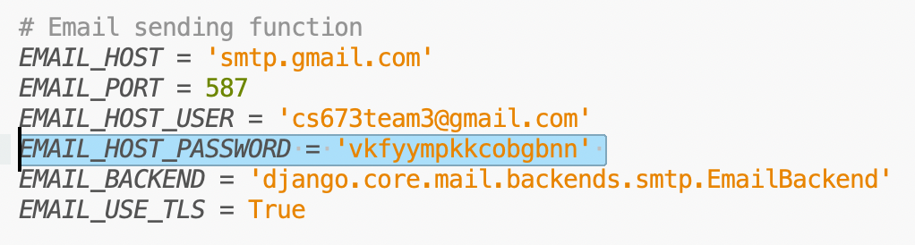
Possible Security Concern
Solutions:
Use environment variables, which is to store data in the kernel of the operating system and is made available to processes through system calls. (Since the program is running on localhost, each student needs to configure the .env file differently due to different systems i.e. Windows, Mac, Linux, which might cause bugs.)
Use enterprise level private email service.

Slide 20
Testing Items and Methods - Zuowen
Functions have been tested:
User Registration, Login, and Profile Management
Dietary Input and Management
Diet Tracking and Reporting
Social Media Function
Data Privacy and Security
Methods:
Unit Testing: For testing individual components/functions of the application.
Integration Testing: To test the interaction between different components of the application.
Acceptance Testing: To ensure the system satisfies the requirements and is ready for delivery.
Security Testing: To identify any potential vulnerabilities or weaknesses.
Performance Testing: To ensure the system performs well under expected and peak load.

Slide 21
Testing Metrics - Zuowen
Test Coverage: This measures the percentage of your code that is covered by your test cases. It gives an idea about the extent of testing performed and which parts of the codebase have been left untested.
Number of Test Cases: This refers to the total number of test cases executed during a testing cycle. It can be further divided into passed, failed, and skipped test cases.
Defect Density: This metric is the number of confirmed defects divided by the size of the software. It is often used to gauge the quality of a codebase or the effectiveness of a testing process.
Pass/Fail Rate: This is a simple metric that calculates the percentage of tests that passed versus those that failed.

Slide 22
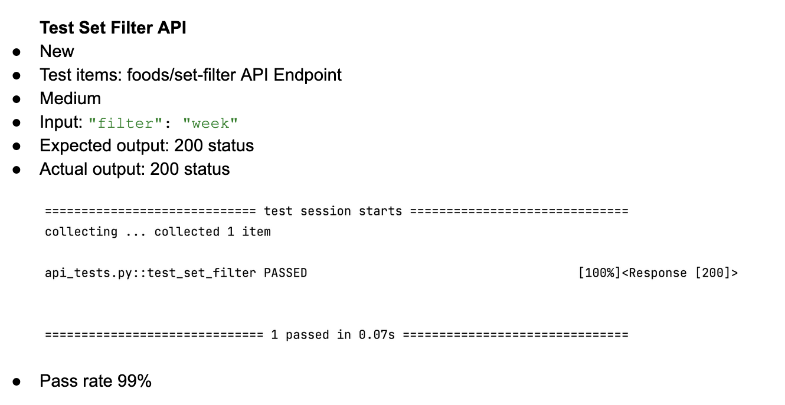
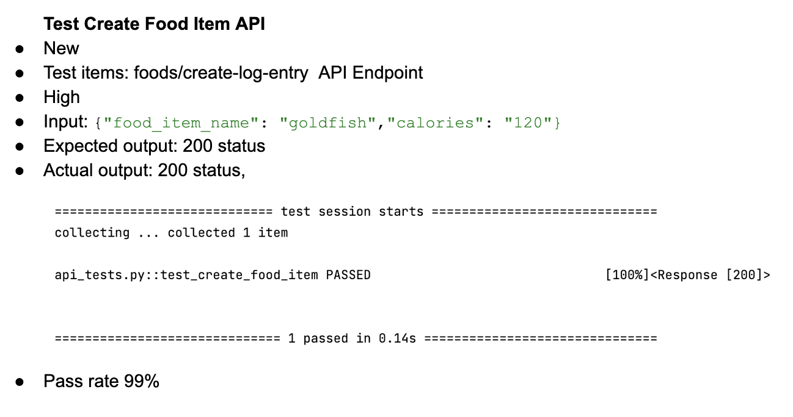
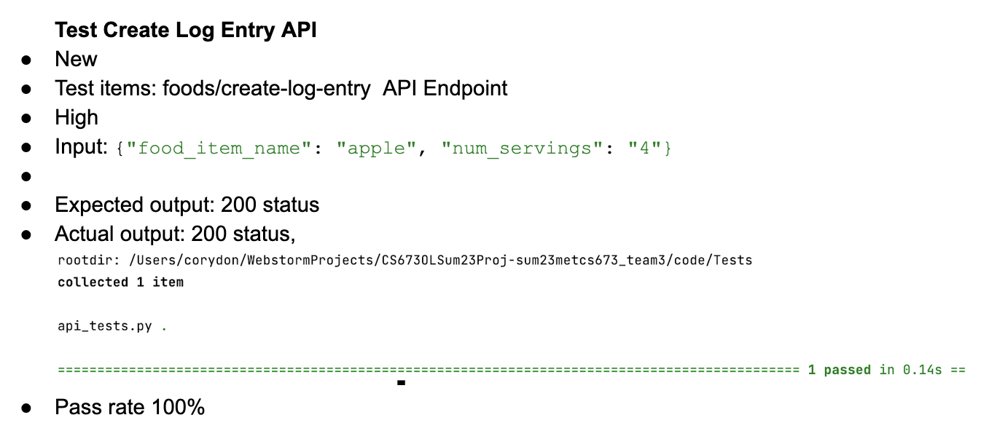

Slide 23
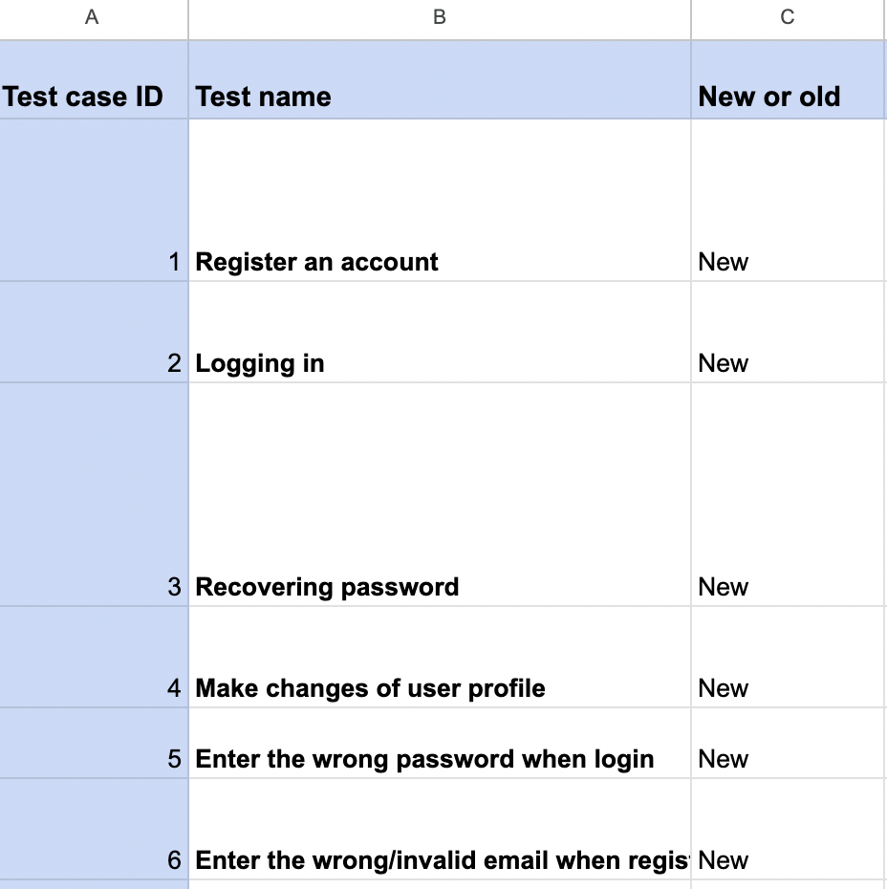
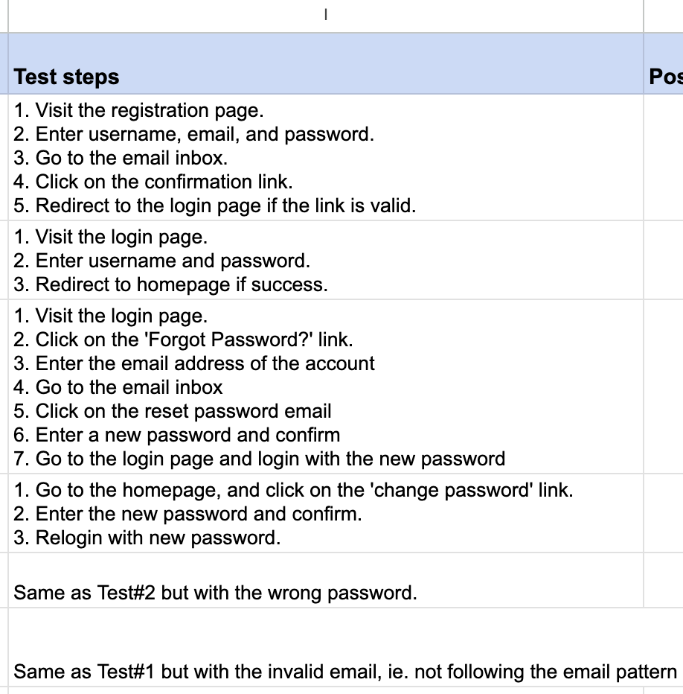
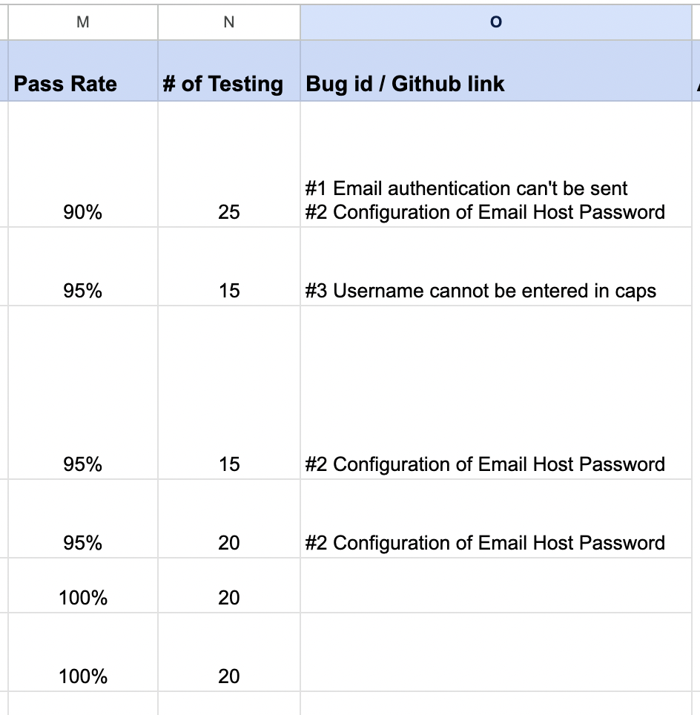
Manual Testing:
Testing name, detailed test steps, pass rate and number of testing, bug details.
Over 95% of code is covered by either manual or unit testing.

Slide 24
Requirement Leader-Alekhya
Requirement analysis:
overview of functional requirements using use case diagram, user stories (examples, total # (planned vs completed), total points), how your project tracks requirements and handles requirement changes, nonfunctional requirements etc.
https://cs673-team3.atlassian.net/jira/software/c/projects/TU673/boards/1

Slide 25
Requirement Analysis-Alekhya
Functional requirements:
User- registration and login
Food database- browse, entry, edit, delete, view, portion
Calorie calculation- track, total, view, visual, history
Social feature- post, interact
Meal planning- goals
Non-functional requirements:
Security
Performance
Reliability
Scalability
Notes:
Didn’t get to edit, interact and goals

Slide 26
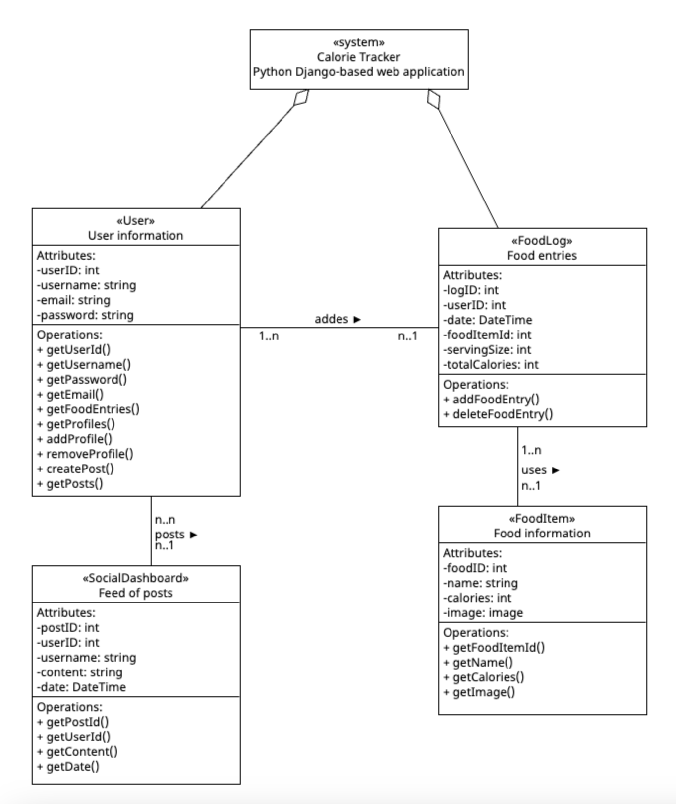
Class Diagram- Alekhya
The class diagram serves as a visual representation of the structure of the app's data model. It helps in understanding the relationships and dependencies between classes,facilitating the development and maintenance of the application.
The class diagram for the Calorie app includes essential classes such as User, FoodItem, FoodLog and SocialDashboard. These classes represent the core entities in the application's domain.
The relationships depicted in the class diagram highlight the associations between classes.

Slide 27
Jira- Alekhya
The epics for the user stories were: User Registration and Authentication, Daily Logging, Calorie Calculation & Tracking, Social Features, Developmental Workflow and each of the iterations
Total 23 planned user stories
Completed 20 user stories
Total story points: 167
Backlog used for tracking and changes
Tracking with progress status

Slide 28
User Story- Alekhya
Example:

